Slide 1
Mérés: loss_valid görbére

Slide 2
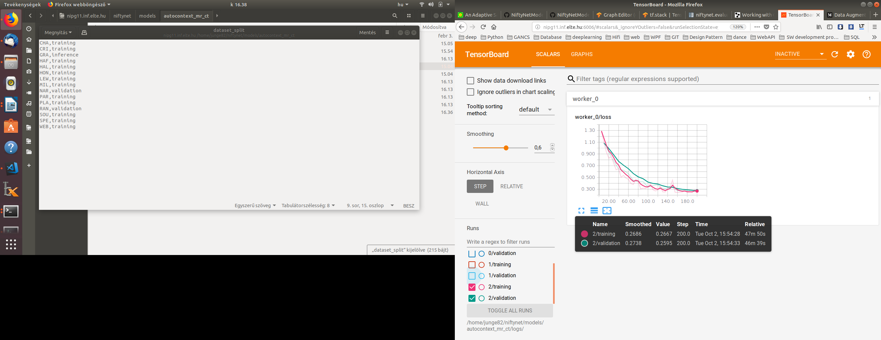
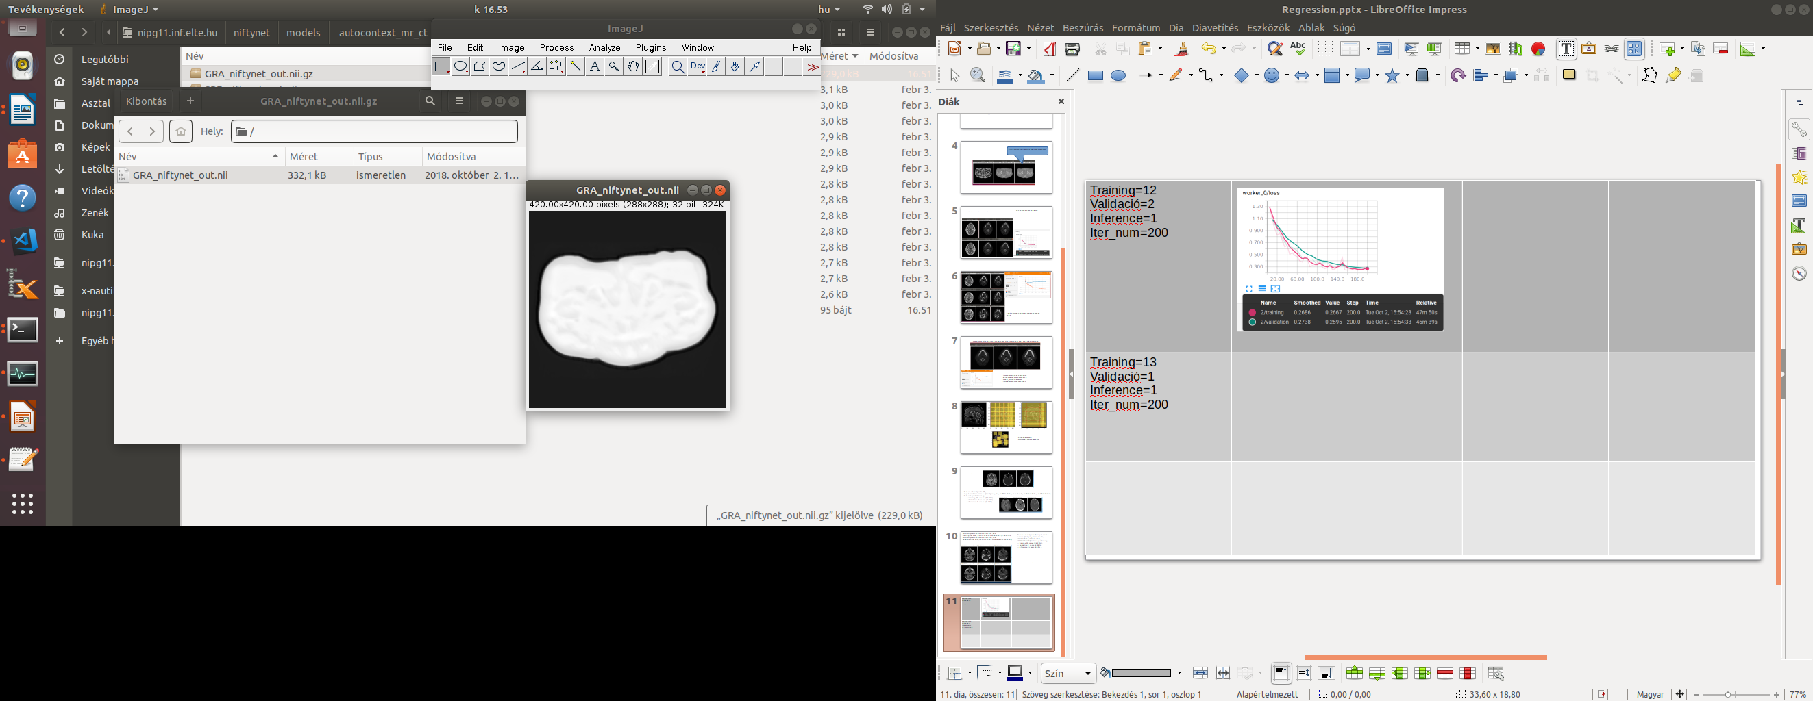
1_autocontext Training=12 (CHA..WEB) Validació=2 (NAR,RAN) Inference=1 (GRA) Iter_num=200 Training:0.26 Validation:0.25
scaling_percentage=(-10.0, 10.0) random_flipping_axes= 0,1
autocontext

Slide 3
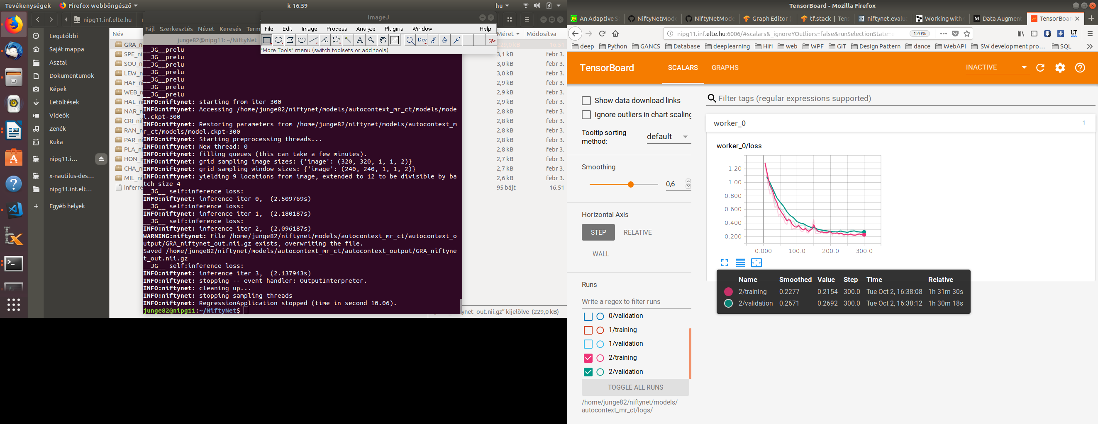
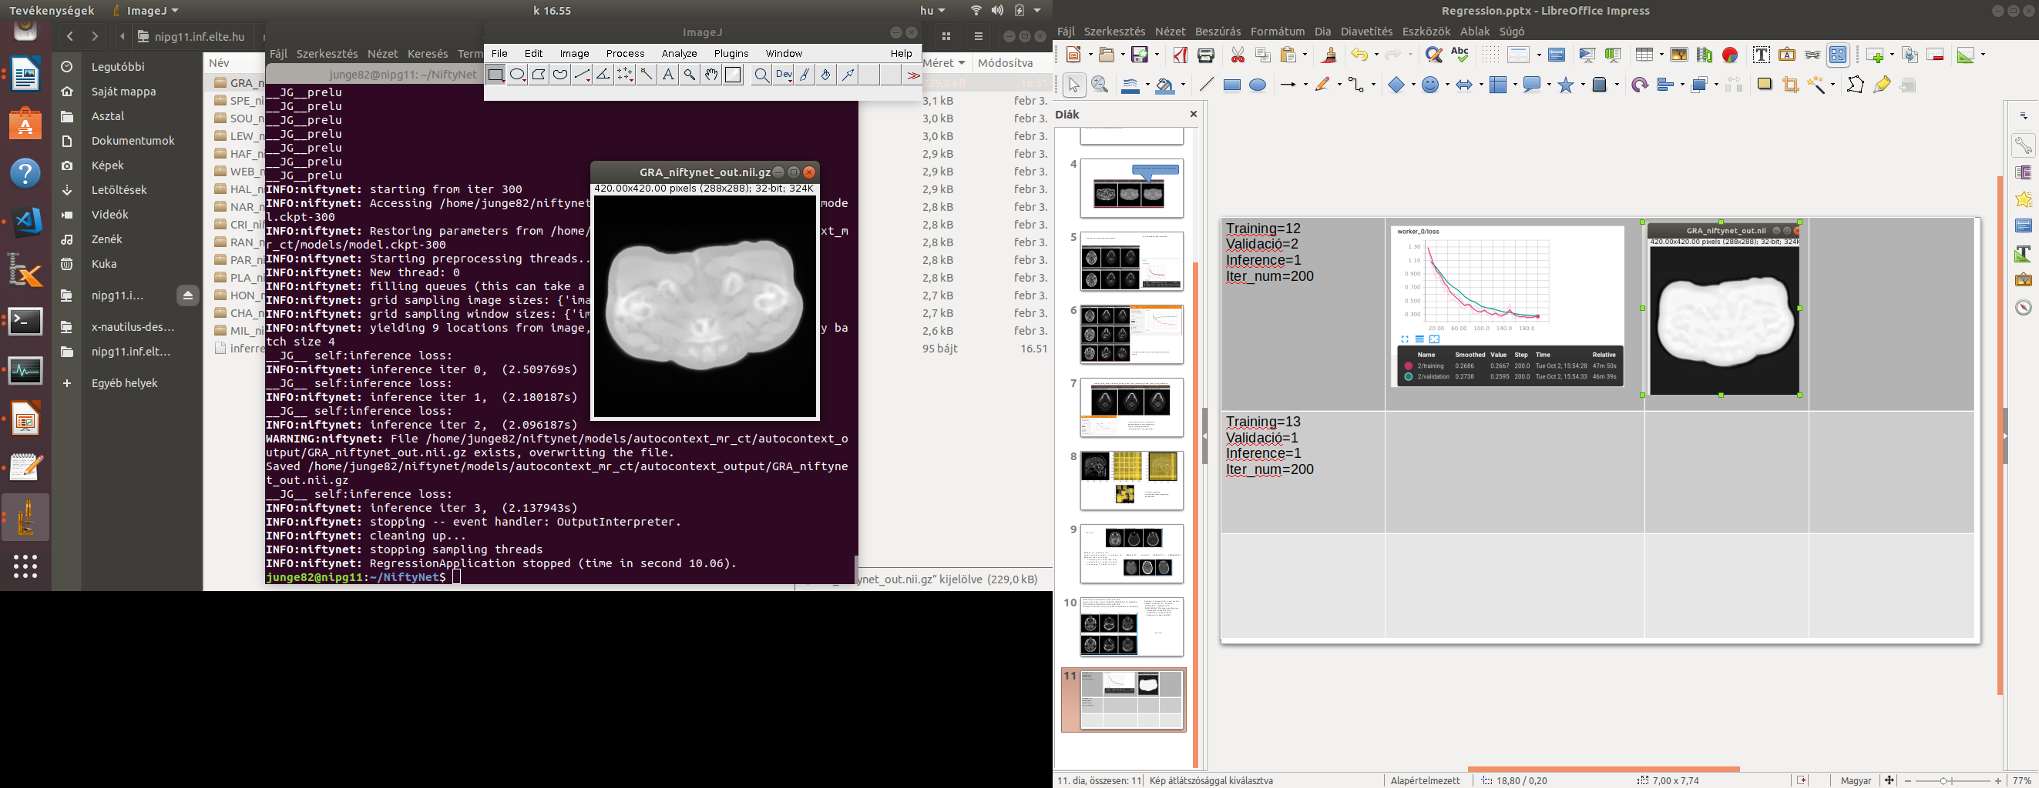
1_autocontext Training=12 Validació=2 Inference=1 (GRA) Iter_num=300 Training:0.21 Validation:0.26
scaling_percentage=(-10.0, 10.0) random_flipping_axes= 0,1

Slide 4
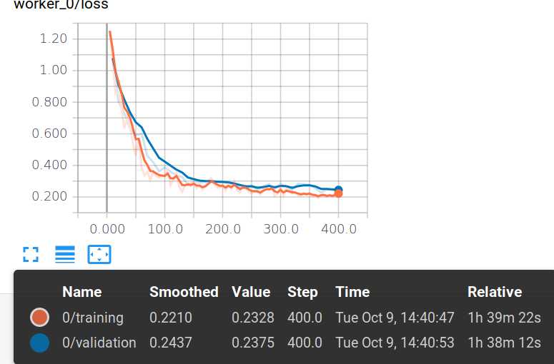
1_autocontext Training=12 Validació=2 Inference=1 (GRA) Iter_num=400
scaling_percentage=(-10.0, 10.0) random_flipping_axes= 0,1

Slide 5
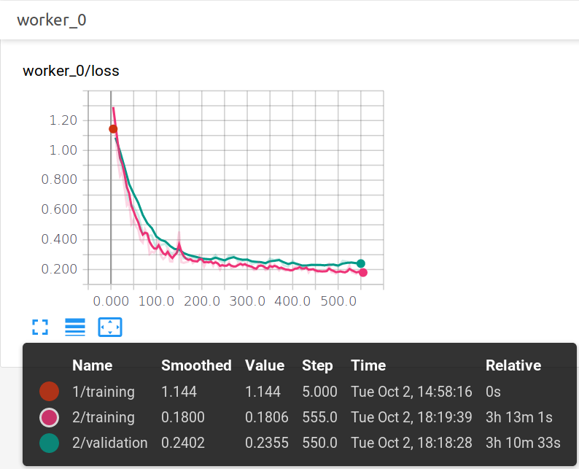
1_autocontext Training=12 Validació=2 Inference=1 (GRA) Iter_num=555
scaling_percentage=(-10.0, 10.0) random_flipping_axes= 0,1
autocontext

Slide 6
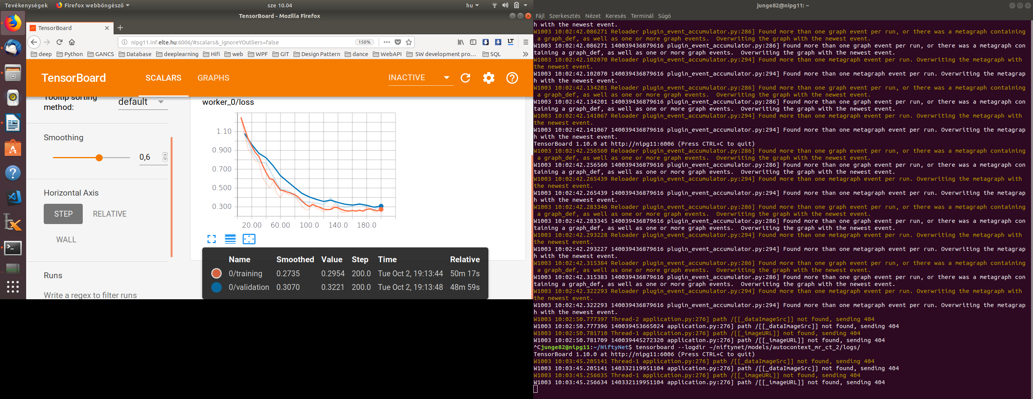
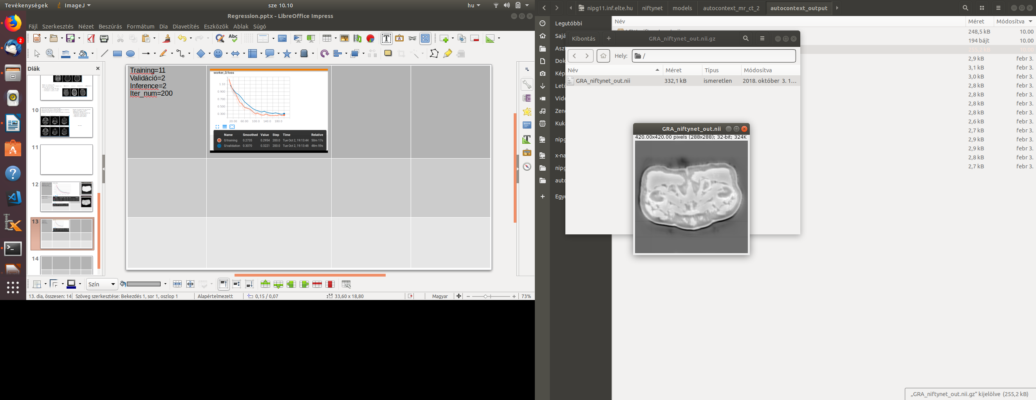
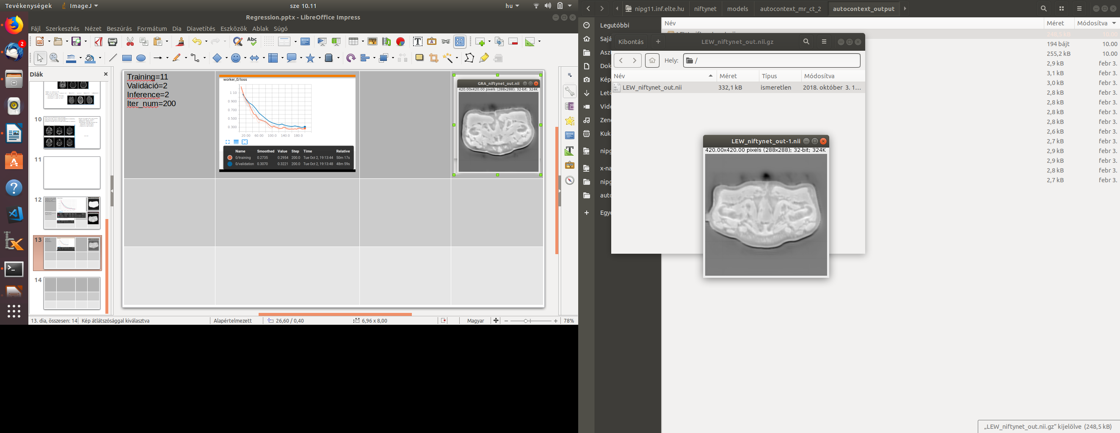
2_autocontext Training=11 Validáció=2 Inference=2 GRA,LEW Iter_num=200 Training: 0.29 Validation: 0.32
scaling_percentage=(-10.0, 10.0) random_flipping_axes= 0,1
autocontext

Slide 7

2_autocontext Training=11 Validáció=2 Inference=2 GRA,LEW Iter_num=400
scaling_percentage=(-10.0, 10.0) random_flipping_axes= 0,1
autocontext

Slide 8
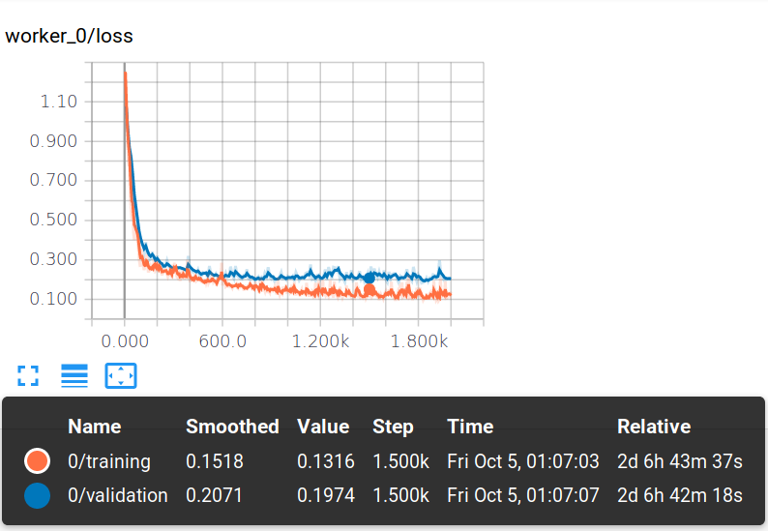
2_autocontext Training=11 Validáció=2 Inference=2 GRA,LEW Iter_num=1500
scaling_percentage=(-10.0, 10.0) random_flipping_axes= 0,1

Slide 9
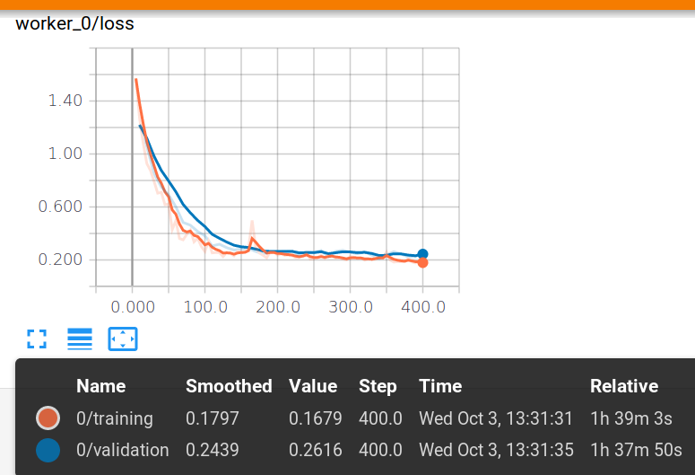
3_autocontext Training=12 Validáció=2 Inference=1 GRA,LEW Iter_num=400
scaling_percentage=(-20.0, 20.0) random_flipping_axes= 0,1

Slide 10

4_autocontext Training=11 Validáció=2 Inference=2 GRA,LEW Iter_num=400
scaling_percentage=(-20.0, 20.0) random_flipping_axes= 0,1

Slide 11

5_autocontext Training=12 Validáció=2 Inference=1 GRA,LEW Iter_num=400
scaling_percentage=(-30.0, 30.0) random_flipping_axes= 0,1

Slide 12

6_autocontext Training=11 Validáció=2 Inference=2 GRA,LEW Iter_num=400
scaling_percentage=(-30.0, 30.0) random_flipping_axes= 0,1

Slide 13

Isample_1 Keep_prob=0.5 (default) Training=12 Validáció=2 Inference=1 Iter_num=400
scaling_percentage=(-10.0, 10.0) random_flipping_axes= 0,1
isample

Slide 14

Isample_2 Keep_prob=0.5 (default) Training=11 Validáció=2 Inference=2 Iter_num=400
scaling_percentage=(-10.0, 10.0) random_flipping_axes= 0,1
isample

Slide 15

Isample_3 Keep_prob=0.5 (default) Training=12 Validáció=2 Inference=1 Iter_num=400
scaling_percentage=(-20.0, 20.0) random_flipping_axes= 0,1
isample

Slide 16

Isample_4 Keep_prob=0.5 (default) Training=11 Validáció=2 Inference=2 Iter_num=400
scaling_percentage=(-20.0, 20.0) random_flipping_axes= 0,1
isample

Slide 17

Isample_5 Keep_prob=0.5 (default) Training=12 Validáció=2 Inference=1 Iter_num=400
scaling_percentage=(-30.0, 30.0) random_flipping_axes= 0,1
isample

Slide 18

Isample_6 Keep_prob=0.5 (default) Training=11 Validáció=2 Inference=2 Iter_num=400
scaling_percentage=(-30.0, 30.0) random_flipping_axes= 0,1
isample

Slide 19
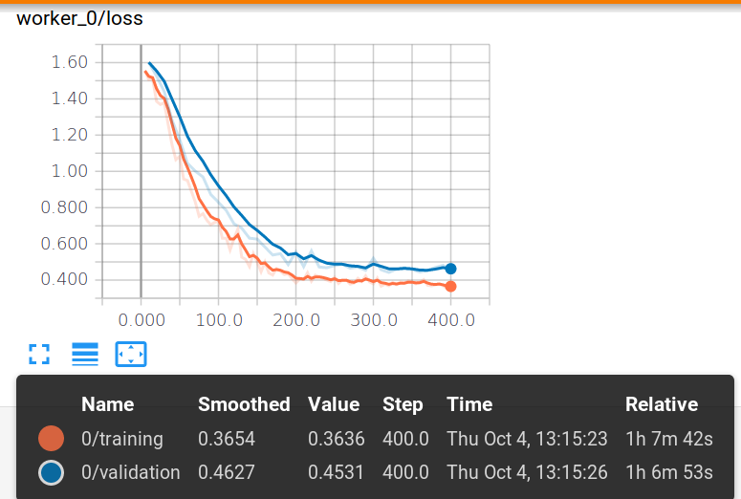
Isample Keep_prob=0.1 Training=12 Validáció=2 Inference=1 Iter_num=400
scaling_percentage=(-10.0, 10.0) random_flipping_axes= 0,1

Slide 20
Isample_1 Keep_prob=0.5 (default) Training=12 Validáció=2 Inference=1 Iter_num=400
scaling_percentage=(-10.0, 10.0) random_flipping_axes= 0,1
isample

Slide 21

Isample Keep_prob=1 Training=12 Validáció=2 Inference=1 Iter_num=400
scaling_percentage=(-10.0, 10.0) random_flipping_axes= 0,1

Slide 22
Autocontext Training=11 Validáció=2 Inference=2 GRA,LEW Iter_num=1500
scaling_percentage=(-10.0, 10.0) random_flipping_axes= 0,1
autocontext

Slide 23
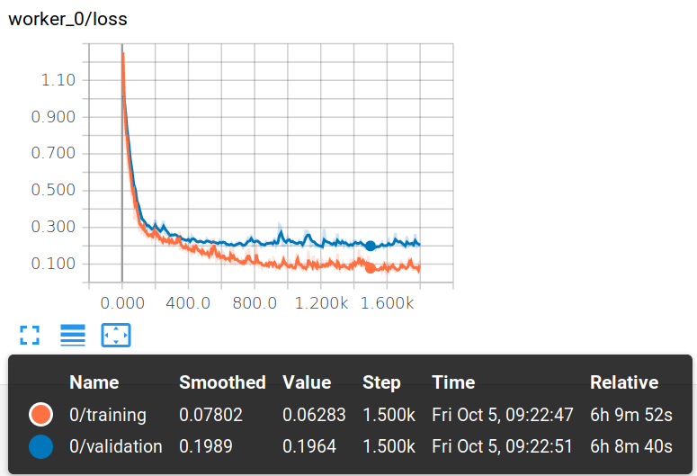
Autocontext Training=11 Validáció=2 Inference=2 GRA,LEW Iter_num=1500
Without augmentation

